Slide 1
Unraveling the Road: Building Regression Models to Predict Car MSRP
Tim Cabaza, Rob Lane, Jae Chung
DS 6372 Applied Statistics
Notes:
Hello everyone and welcome to our presentation focused on unraveling the road in building efficient regression models to better predict car MSRP.

Slide 2



MEET THE TEAM
TIM CABAZA
ROB LANE
JAE CHUNG​
Notes:
I’d like to introduce our team today. My name is Jae Chung and I had the honor of working with my esteemed colleagues, Tim Cabaza and Rob Lane. Throughout our research, we delved into the intricacies of developing accurate and robust models that can effectively estimate car prices. Today, we are excited to present our findings, which we believe will provide valuable insights and practical guidance for anyone involved in car pricing analysis. Join us as we explore the journey of constructing reliable regression models and discover the key factors that drive car MSRPT predictions.

Slide 3
agenda
INTRODUCTION
DATA EXPLORATION
OBJECTIVE 1
OBJECTIVE 2
CONCLUSION
Notes:
Here is our agenda for today’s presentation. First, we’ll introduce the purpose behind the analysis. Next, we'll delve into our data exploration journey. We'll share insights on how we approached the dataset, the techniques we used for data cleaning, and any challenges we encountered. Additionally, we'll highlight the key questions that arose during the exploration phase and how we effectively addressed them. Then we’ll share about Objective 1 and Objective 2 and our findings and conclusions regarding each. And lastly, we’ll conclude our presentation by summarizing our findings and providing recommended next steps.

Slide 4
Introduction
Purpose | DATASET
Notes:
As mentioned, we will introduce the purpose behind our analysis. We’ll also discuss the dataset provided and set the groundwork for the data-wrangling conducted during the exploration process.

Slide 5
purpose
To identify and compare key relationships between various predictors and the MSRP of cars to provide insight into predictive performance.
Notes:
The purpose of our research and analysis was to gain a comprehensive understanding of the relationships between various predictors and the MSRP of cars. Our aim was to uncover valuable insights that can enhance the predictive performance of our models. We explored the data, employing various techniques to refine and modify it in order to achieve more accurate and meaningful results. Additionally, we strived to provide clear and insightful interpretations of our findings to facilitate informed decision-making in the automotive industry.

Slide 6

Dataset
A csv file of car data with features including make, model, year, engine, and other properties of the car used to predict MSRP.
Notes:
For our analysis, we utilized a comprehensive CSV file containing car data, encompassing a wide range of features such as make, model, year, engine specifications, and other properties of the cars. This dataset served as the foundation for our endeavor to predict the MSRP of vehicles. By harnessing the wealth of information present in this dataset, we aimed to uncover the underlying patterns and relationships that influence the pricing of cars. Our objective was to leverage this data to build robust regression models that can accurately predict the MSRP based on the given set of features. Through meticulous exploration, analysis, and interpretation, we aimed to provide valuable insights into the factors driving the pricing dynamics in the automotive industry.

Slide 7
Data Exploration
Eda process
Notes:
Next, we’ll dive into our data exploration journey. We’ll share insights on how we approached the dataset, the techniques we used for data cleaning, and any challenges we encountered. Additionally, we’ll highlight the key questions that arose during the exploration phase and how we effectively addressed them.

Slide 8
Question of interest 1
What is the distribution of the MSRP within this dataset?
Are there any unusual patterns or outliers?
Notes:
The first question of interest we explored was “What is the distribution of the MSRP within this dataset? And are there any unusual patterns or outliers?”

Slide 9
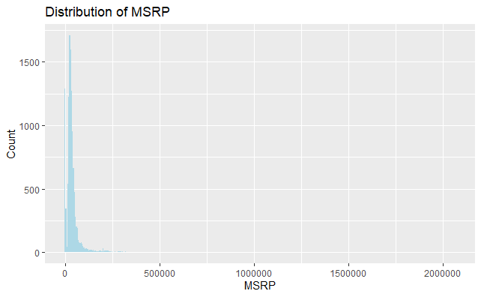
Question of interest 1
Significant right-skew
Evidence of outliers
Evidence of missing data
Data-cleaning required
Notes:
The distribution of the MSRP variable in our dataset reveals interesting insights into the price range of vehicles. By generating a histogram, we observe a significant right skew, indicating a higher concentration of vehicles with lower prices and a long tail of higher-priced vehicles. However, what stands out are the outliers on the right end of the distribution. Additionally, on the left side of the histogram, we noticed a cluster of cars with missing or incorrect MSRP values.

Slide 10
Question of interest 2
Are there any missing values or outliers in the dataset?
How should they be handled?
Notes:
Next, the questions that arose was “Are there actually any missing values and outliers.” If we were to find any, how would they be handled.

Slide 11
Question of interest 2
 | MSRP | Vehicle
Med | $29,995 | 2016 Dodge Challenger
Max | $2,065,902 | 2008 Bugatti Veyron 16.4
Significant variance in MSRP when exotic vehicles are included.
Notes:
When diving into the dataset, we found that there were a few exceptional cars, such as the Bugatti Veyron 16.4, with an MSRP of over 2 million dollars, contributing to the heavy right skew. This MSRP price point varied significantly from where the median landed as indicated by the Dodge Challenger of about 30000 dollars.

Slide 12
Question of interest 2
Missing values
Horsepower
69
Cylinders
30
Doors
6
Notes:
We were able to also find several records that were missing data. These inaccuracies and missing data points further underscore the need for thorough data cleaning and preprocessing before constructing our regression models.

Slide 13
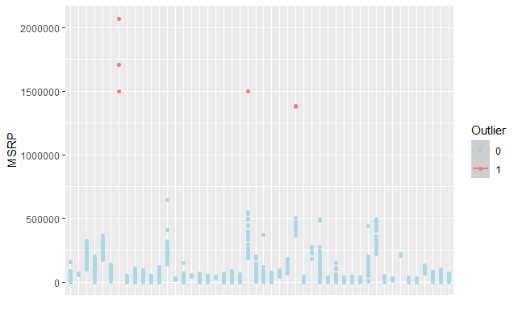
Question of interest 2
Outliers
Notes:
Once again, here we get a better glimpse at the outliers within the dataset. Every one of the red dots on the visual was identified as being exotic cars.

Slide 14
Question of interest 2
Removed exotic cars to handle outliers
Removed records with NA that couldn't be populated easily
Notes:
Understanding the distribution of MSRP is crucial for identifying any unusual patterns, such as extreme outliers or missing data, that may impact our modeling process. It emphasizes the importance of data cleaning and robust statistical techniques to ensure accurate interpretations and reliable predictions. So, upon verifying the presence of outliers and missing data, we decided to remove records that couldn’t be populated easily as well as completely removing exotic cars from the dataset altogether. These decisions were agreed upon as there would still be an ample sample size of vehicles more easily accessible to the general public.

Slide 15
Question of interest 3
How do the individual predictor variables relate to the MSRP?
Are there any strong correlations?
Notes:
Next, we examined the relationships between each individual predictor variable and the target variable, MSRP. The goal was to identify any strong correlations or associations that could potentially help us in predicting the MSRP. With many of the variables being categorical, we aimed to uncover any significant relationships between the predictor variables and the target variable through plotting boxplots for all the categories against MSRP. Strong correlations would indicate that certain predictor variables have a notable influence on the MSRP. However, it's important to note that the identification of strong correlations was part of the broader analysis and objectives following the EDA process. The main focus during EDA was to understand the relationships and trends between the predictor variables and the MSRP, laying the groundwork for further analysis and model building.

Slide 16
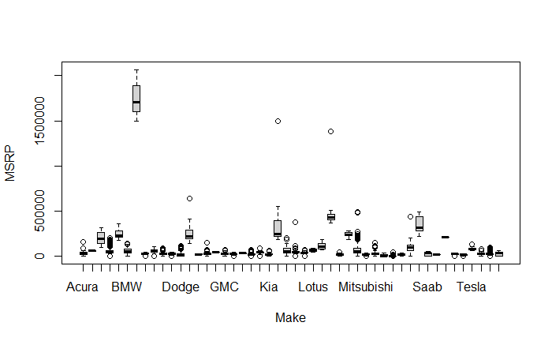
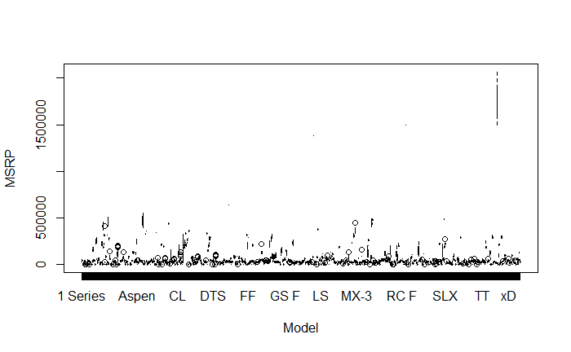
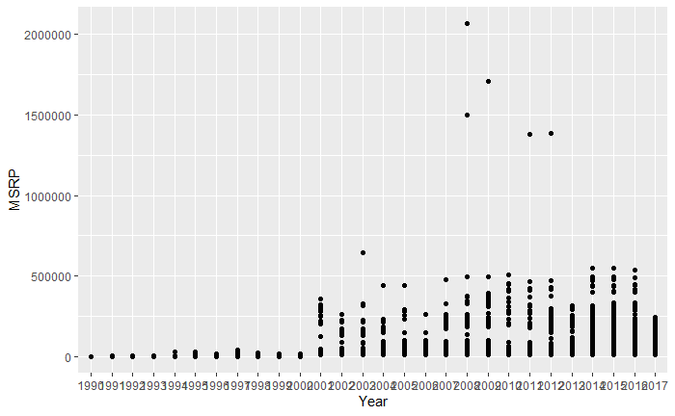
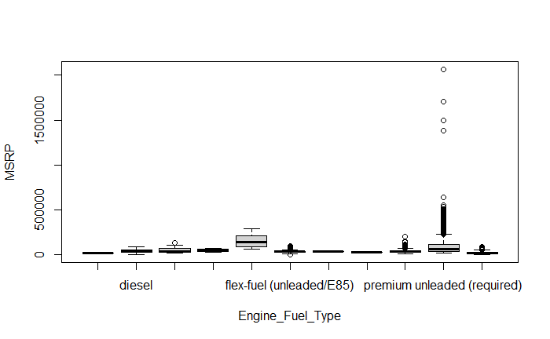
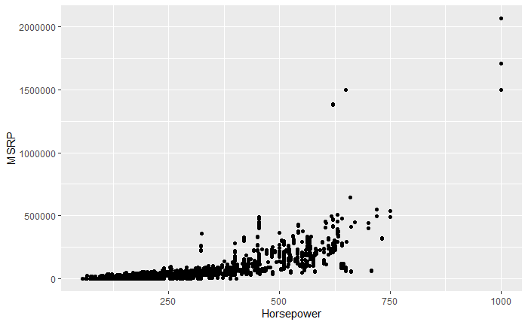
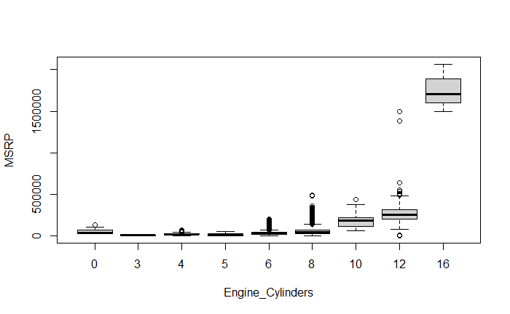
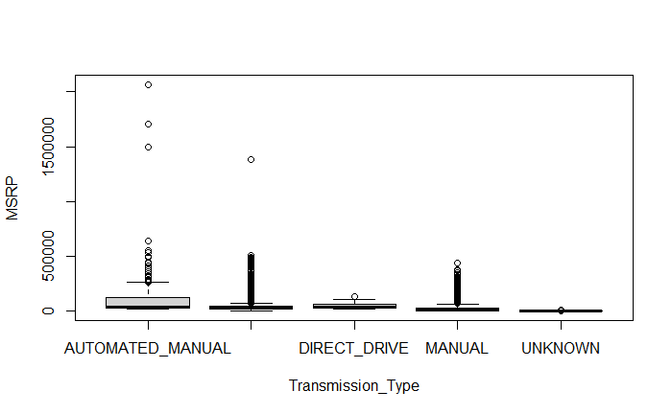
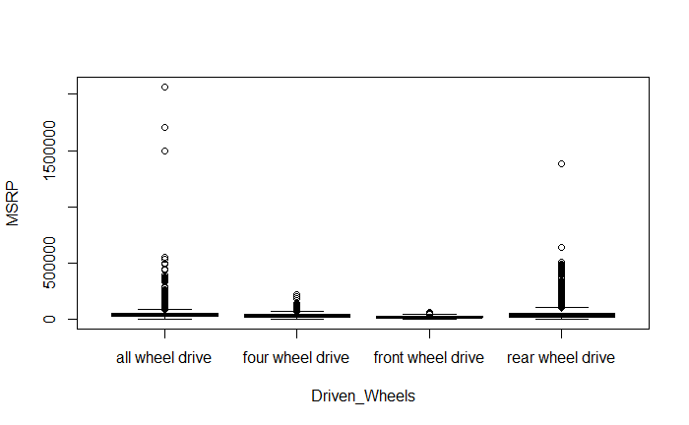
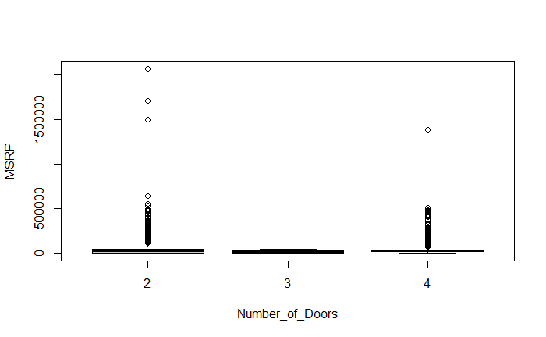
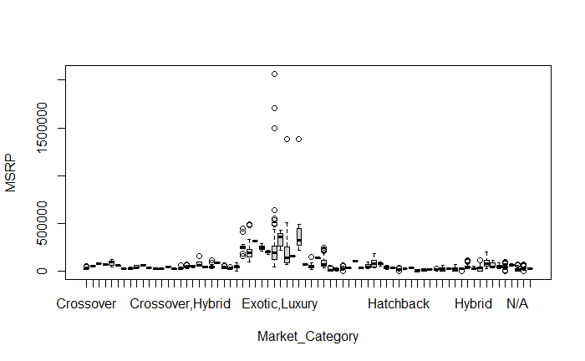
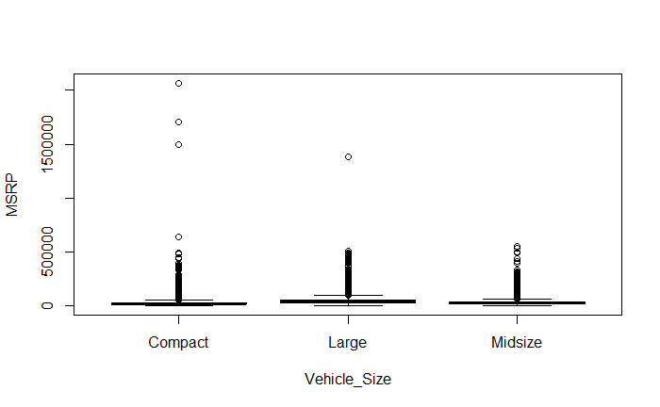
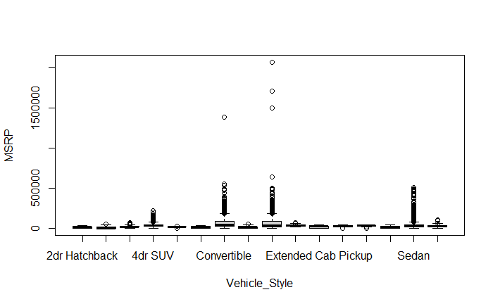
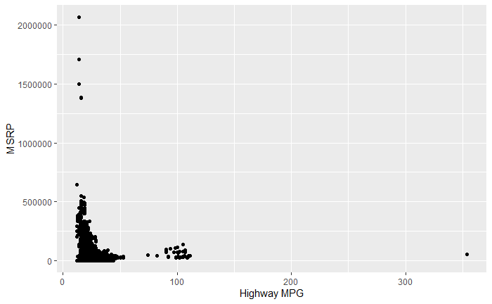
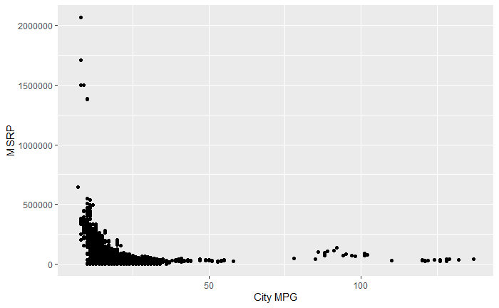
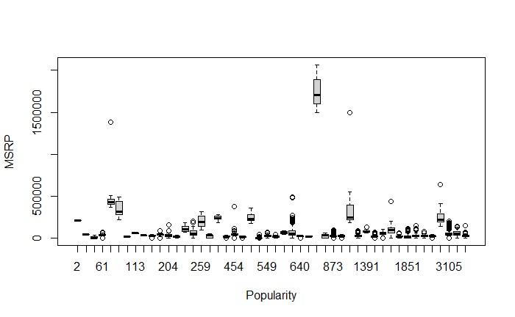
Question of interest 3
Notes:
From the box plots and scatter plots, we can observe some correlations between certain variables and the MSRP. Variables such as cylinders, make of the car, horsepower, and highway and city MPG appear to have some relationships with the MSRP. However, it's important to note that this initial observation is based on a visual inspection, and further analysis is required to quantify and interpret these correlations accurately. In the subsequent steps, we will dive deeper into the analysis and conduct more rigorous assessments of the relationships between predictor variables and the MSRP to gain a clearer understanding of their impact.

Slide 17
Final Question of interest
So, based on the initial exploration of the dataset, which predictor variables show the strongest association with the MSRP?
Which model would be best to predict MSRP?
Notes:
Throughout the initial exploration of the dataset, we sought to uncover the predictor variables that exhibit the strongest association with the MSRP. By analyzing the correlations and patterns, we were able to identify several key variables that showcase a notable relationship with the MSRP. Specifically, variables such as cylinders, horsepower, and MPG emerged as potential influential factors, indicating their potential impact on predicting the MSRP accurately.
Moreover, the question of which model would be most suitable for predicting the MSRP naturally arose during our EDA process. This inquiry sets the stage for our subsequent objectives, where we delve into building regression models and evaluating their performance. By employing rigorous analysis techniques, including hypothesis testing, interpretation of regression coefficients, and model diagnostics, we aim to identify the optimal model that can effectively predict the MSRP with precision and reliability.
By addressing these questions, we aim to provide valuable insights into the relationships between predictor variables and the MSRP, as well as determine the most effective model for predicting the MSRP accurately.

Slide 18
Objective 1

Slide 19
Objective 1
Build an interpretable model with key relationships.
Summary statistics.
Interpret coefficients, consider practical and statistical significance.
Notes:
Goals for Objective 1:
Build an interpretable model that identifies key relationships between predictor variables and MSRP.
Provide detailed summary statistics and explain the model building process.
Interpret the regression coefficients, consider practical and statistical significance of predictors, and address relevant questions using the model.

Slide 20
Exploring model 1
Training / Validation split: 50%
Simple Linear Regression Used
All variables considered with no complexity or transformations
Notes:
While starting to build our first model:
Data was split 50/50 between training and validation sets
A simple linear regression fit was done and we evaluated the results
All variables are included and no transformations, interactions, or polynomials were used during the initial phase

Slide 21
Linear Model variables
Response | Explanatory
"msrp" | "origin_country" "year" "fuel" "hp" "cylinders" "transmission" "drive" "doors" "style" "mc_performance" "mc_high_performance" "mc_crossover" "mc_luxury" "mc_flex_fuel" "mc_hybrid" "mc_tuned" "avgmpg"
Notes:
Here are our variables for our initial Model 1. Note primarily that MSRP has not been transformed.

Slide 22
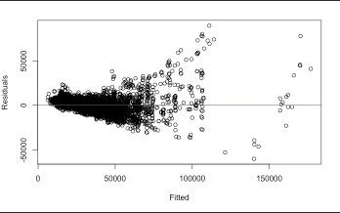
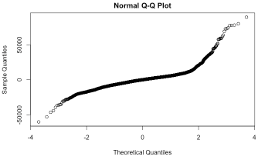
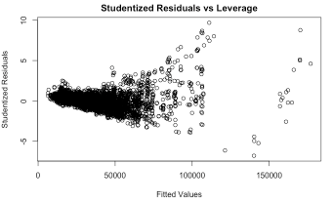
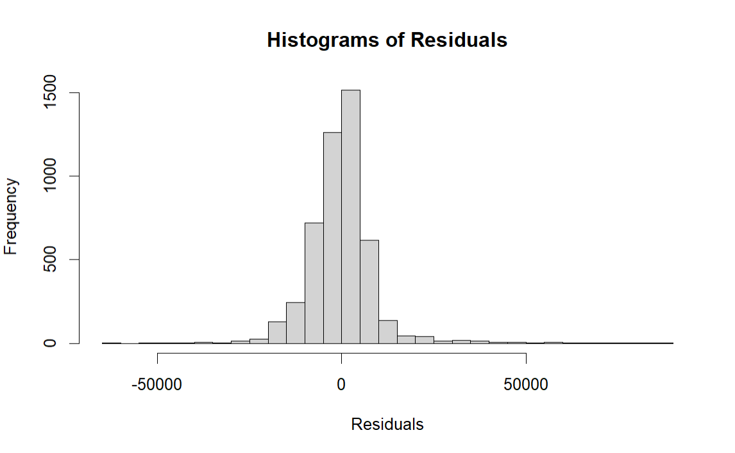
Model 1: non-linear response
Residuals vs. Fitted (Predicted Values):
Funnel-shaped residual plot
QQ Plot:
Evidence of non-linearity (heavy tail)
Histogram:
Appears fairly normal, although may have a stronger peak than usual.
Notes:
Our charts here show why a simple linear model is not the most optimal.
Residuals are illustrating a classic funnel shape indicating a constant variance issue
QQ Plot shows evidence of non-linearity (heavy tail)
Histogram appears fairly normal, although may have a stronger peak than usual.
The best characteristic here is that there is no unexplained trend in the residual line, but it isn’t a proper linear response which is needed for the assumptions.

Slide 23
Log-linear Model variables
Response | Explanatory
log(“msrp”) | “origin_country” “year” “fuel” “hp” “cylinders” “transmission” “drive” “doors” “style” “mc_performance” “mc_high_performance” “mc_crossover” “mc_luxury” “mc_flex_fuel” “mc_hybrid” “mc_tuned” “avgmpg”
Notes:
Having seen the previous issues, we determined that the best course of action would be to log the response variable and explore the results.

Slide 24
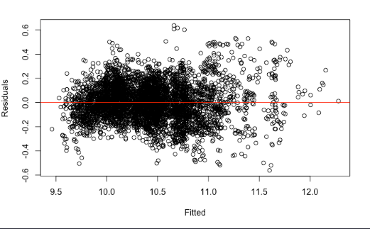
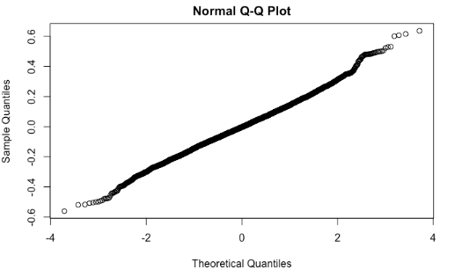
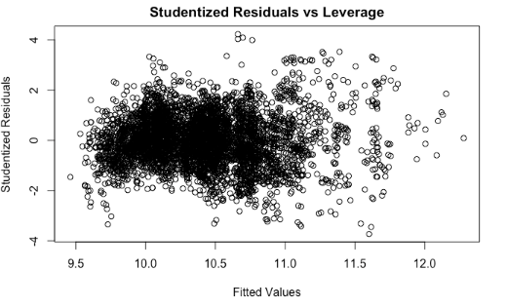
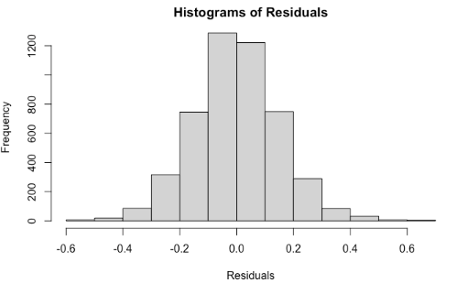
Log-linear Model assumptions
Residuals vs. Fitted (Predicted Values):
Random Cloud
No Overall Trend
QQ Plot:
Normal
Histogram:
A normal distribution
Studentized Residuals vs. Leverage:
No outliers identified
Notes:
Here, we address the model assumptions for our improved log-linear model.
As demonstrated here, simply logging the response variable has improved several issues.
Our variance seems much more random. Although the variance still slightly expands towards the right of our residuals chart, it is now a small enough difference that our assumptions here are met. The lack of an overall trend in residuals further indicates that the explanatory variables have adequately captured the overall pattern of our data.
Both our Q-Q Plot and our histogram of residuals indicate stronger normality than before.

Slide 25
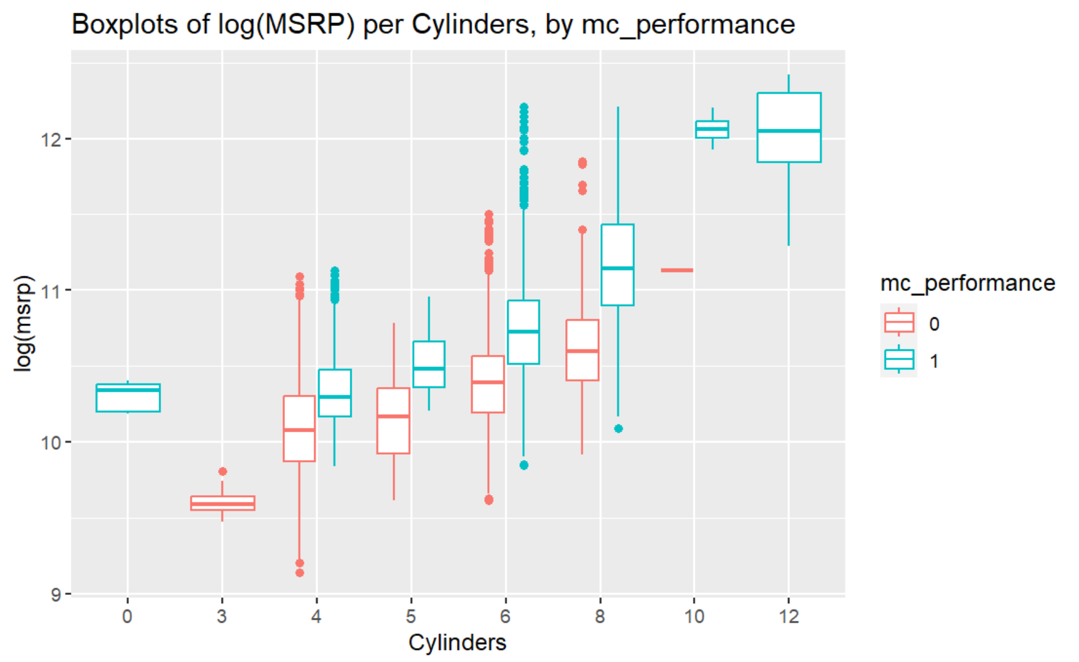
Interactions: cylinders vs. performance
Notes:
We expected to see a stronger interaction term between cylinders and whether or not a car was labeled as a performance vehicle. While there is a bit of evidence here to support that, it was not strong enough evidence to be significant. If you were to draw a line through the general trend of how these affect price, the line is within the interquartile range of all the figures, and generally around the same portion of the IQR for each section. There may be a slight interaction, but just not a significant impact when it comes to the asking price of a new vehicle.

Slide 26
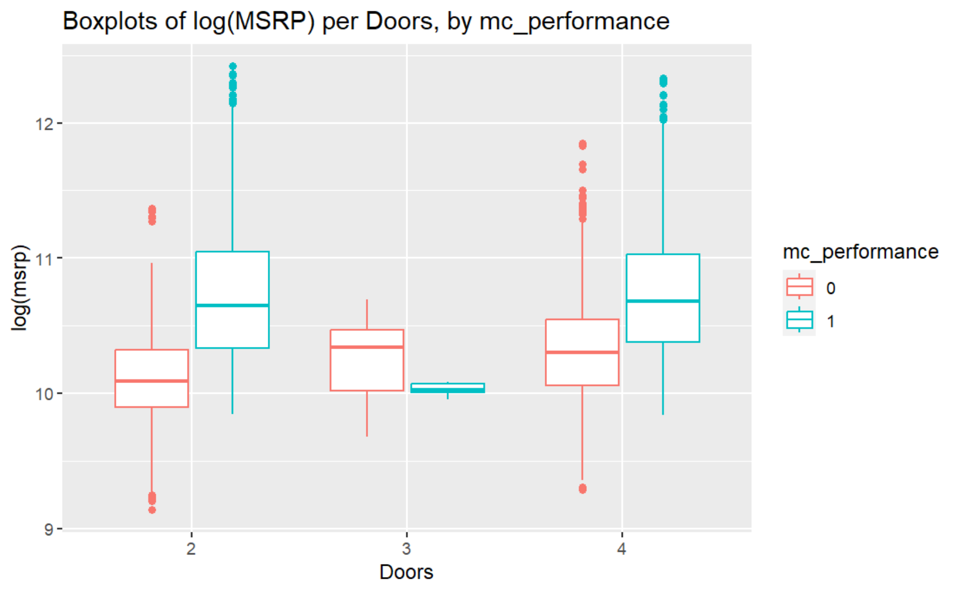
Interactions: doors vs. performance
Notes:
Another thought we had was that there could be an interaction between the number of doors and performance. Part of the reasoning to explore this is that a typical performance car has 2 doors.
Although at a glance, it seems like there could be an interaction term because of what is shown on 3-door cars, the problem is that there are very few 3-door cars that are labeled as performance. With a small sample size for that subcategory, there is not enough evidence to suggest that there is a substantial interaction here.

Slide 27
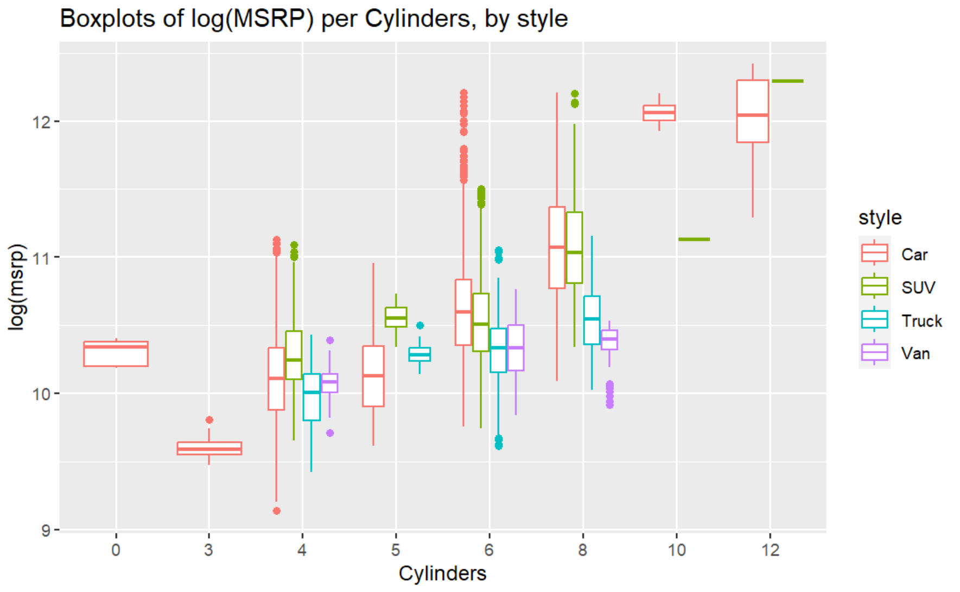
Interactions: cylinders vs. style
Notes:
When checking for interactions between the number of cylinders vs. style of vehicle, we run into similar problems as before. The general relationship is pretty similar, except for 5 cylinder vehicles, but we again had a very low sample of cars in each of those subsets. There doesn’t seem to be a strong interaction here, and we didn’t find a significant improvement to our model by including them.

Slide 28
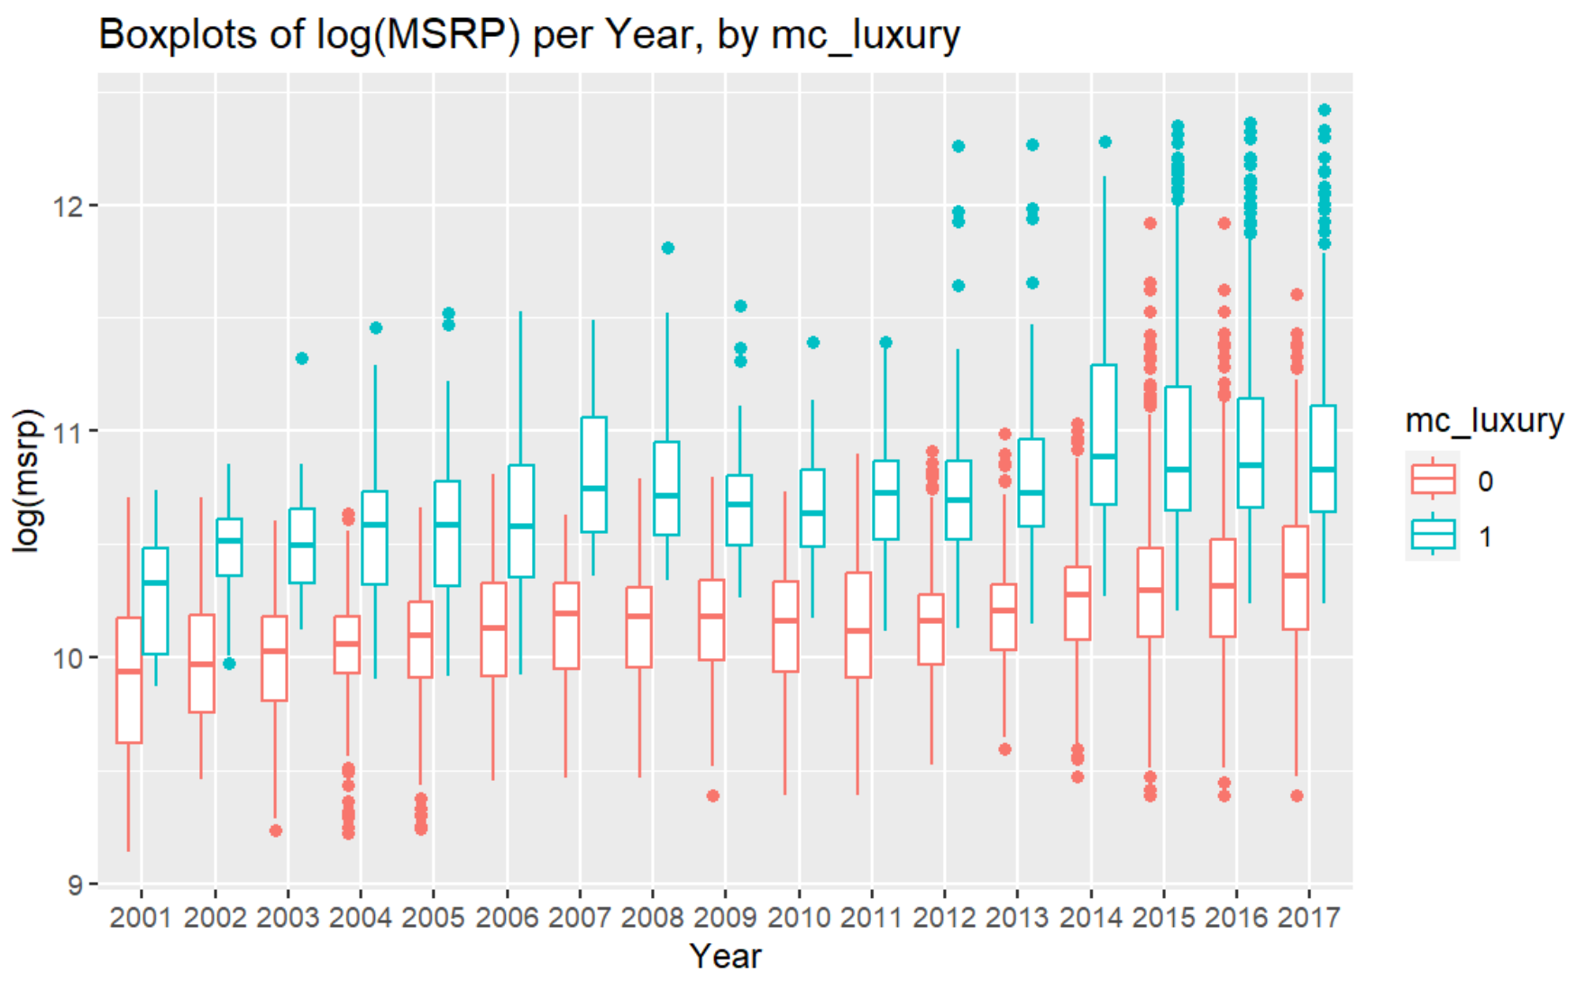
Interactions: year vs. luxury
Notes:
Here, we explored if there were a link between luxury vehicles and the year. The thought here was that with different market conditions in each year, the demand for luxury vehicles could create a varying difference in price between luxury and standard segments. That did not appear to be the case for us.

Slide 29
Reference values
Field | Reference Value
Origin_country | American
Year | 2001
Fuel | Diesel
Cylinders | 0
Transmission | AUTOMATED_MANUAL
Drive | All wheel drive
Doors | 2
Style | Car
Field | Reference Value
mc_performance mc_high_performance mc_crossover mc_exotic mc_luxury mc_flex_fuel mc_hybrid mc_tuned | 0
Notes:
In R, reference values are generated for all categorical inputs for a linear model. By default, this is set to the first alphabetical option. In our data, there is no vehicle which is made entirely of reference values.
Because we removed electric vehicles, a car with 0 cylinders would be a rotary engine, and those have never been made to burn diesel fuel.

Slide 30
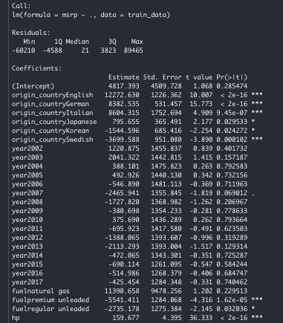
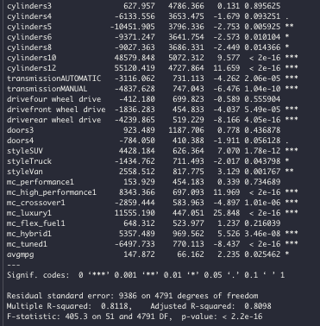
Summary table
Input Variable | Input Type | Reference
origin_countryEnglish | Categorical | $12,273
Fuelpremium unleaded | Categorical | -$5,541
Cylinders10 | Categorical | $48,580
transmissionAUTOMATIC | Categorical | -$3,116
Hp | Numeric | $160
Avgmpg | Numeric | $148
Notes:
To the right is our list of coefficients. This list is significantly longer than our inputs, but this is typical when modeling categorical variables.
Rather than go through the whole list in detail, I will briefly summarize the main points from a few inputs. In all following interpretations, it should be understood that this only applies when controlling for all other variables.
A car from England typically costs over $12,000 more than a car from America.
There is not a significant difference in price between the selected years in our model.
Cars which use premium fuel are associated with a lowered MSRP of $5,541.
A 10-cylinder car is associated with a $48,580 increase in price when compared to rotary engines.
An automatic transmission is associated with a $3,116 decrease in price when compared to an automated manual transmission, which is also known as a dual-clutch transmission. This reference feature is typically found on performance cars.
An increase of 1 horsepower is associated with an increase in MSRP of about $160.
An increase of 1 average mile per gallon is associated with an increase in MSRP of about $148.

Slide 31
Objective 2

Slide 32

Objective 2
Increase the complexity of the model from objective 1
Compare multiple regression models and one nonparametric model
Evaluate the performance of each model using appropriate metrics
Provide insights into findings and suggest recommendations for selecting the most suitable model
Notes:
Increase the complexity of the model from objective 1
Transformations and and the possibility of Interactions
Polynomials to add complexity
Explore Automated Feature Selection
We create and compare two multiple regression models and one nonparametric model
Evaluate the performance of each model using appropriate metrics
Model 2: GLMNET-Lasso Feature Selection
Model 3: GLMNET-Lasso Feature Selection + Additional Complexity
Model 4: Regression Tree
Provide insights into findings and suggest recommendations for selecting the most suitable model

Slide 33
model 2: Selection via glmnet lasso
To explore automated variable selection, the GLMNET package in R was utilized to perform the regularization technique lasso.
This will address any problem of overfitting by performing feature selection and penalizing the coefficients of the model towards zero.

Slide 34
Model variables
Response | Explanatory
log("msrp“) | "origin_country" "year" "fuel" "hp" "cylinders" "transmission" "drive" "doors" "style" "mc_performance" "mc_high_performance" "mc_crossover" "mc_luxury" "mc_flex_fuel" "mc_hybrid" "mc_tuned" "avgmpg"

Slide 35
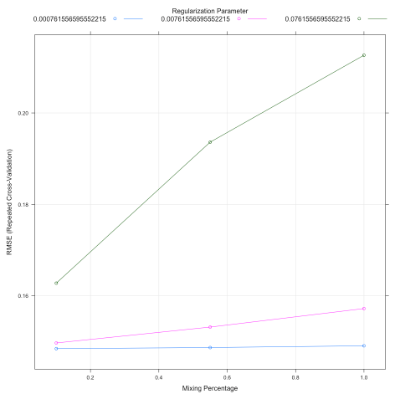
10 fold cross-validation
Here we are performing a 10 fold cross-validation for various mixing and penalty terms on the training dataset which contains 50% of the original data.

Slide 36
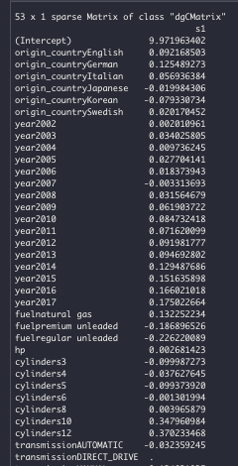
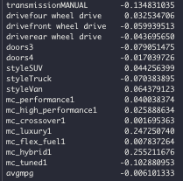
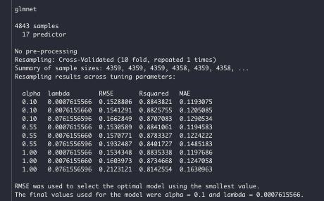
Model results
MSE | RMSE
1797617680 | 42398.32

Slide 37
model 2: Adding complexity with polynomial and feature selection via glmnet
To explore added complexity a polynomial to the 4th degree was added to “hp” and ”avgmpg” to the automated feature selection.
The idea behind adding complexity is that we are attempting to increase the accuracy of our model. Given that we are only trying to predict adding complexity is an appropriate technique to utilize.

Slide 38
Model variables
Response | Explanatory
log("msrp“) | "origin_country" "year" "fuel" poly("hp“^4) "cylinders" "transmission" "drive" "doors" "style" "mc_performance" "mc_high_performance" "mc_crossover" "mc_luxury" "mc_flex_fuel" "mc_hybrid" "mc_tuned" "avgmpg"

Slide 39
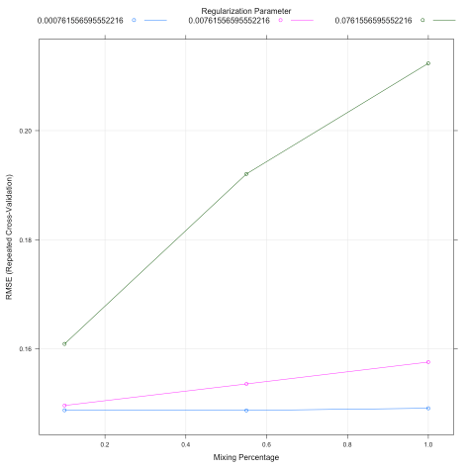
10 fold cross-validation
Here we are performing a 10 fold cross-validation for various mixing and penalty terms on the training dataset which contains 50% of the original data.

Slide 40
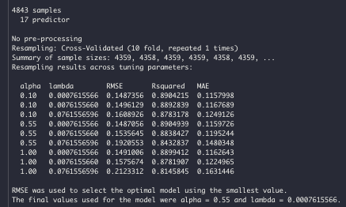
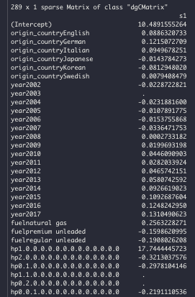
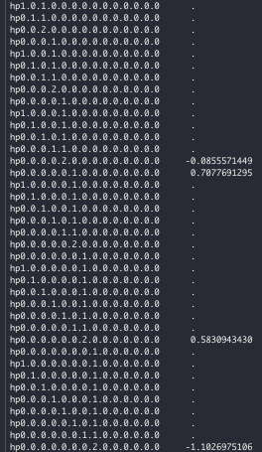
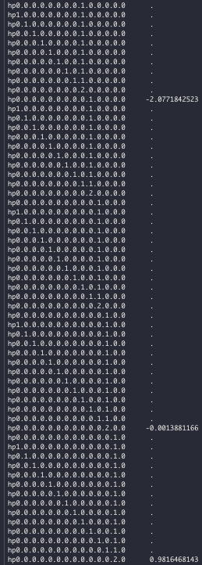
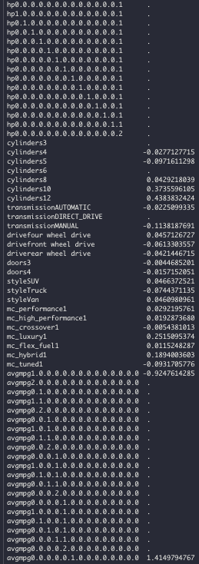
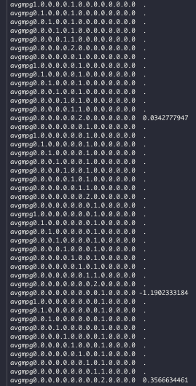
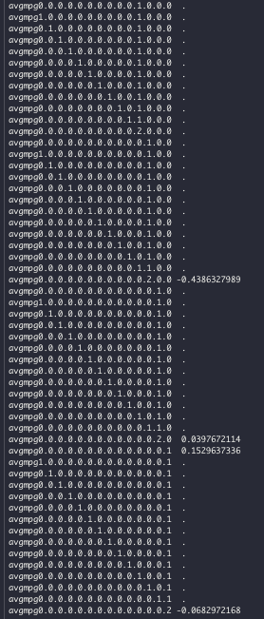
Model results
MSE | RMSE
1829156580 | 42768.64

Slide 41
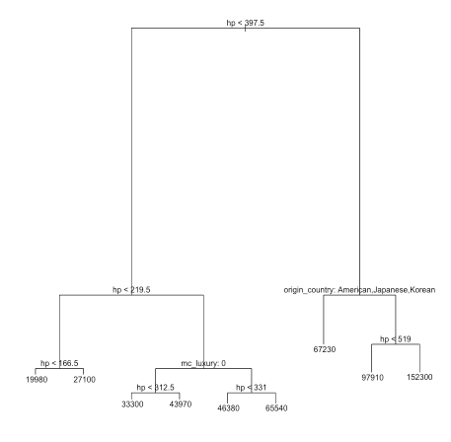
model 3: Non-parametric Regression tree
To compare our previous linear regression models performance to Non-Parametric model we decided to run regression tree. The built in R function does feature selection automatically as its run.
The variables used by the regression tree are horsepower, mc_luxury and origin of country

Slide 42
Model variables
Response | Explanatory
"msrp“ | "origin_country" "year" "fuel" "hp“ "cylinders" "transmission" "drive" "doors" "style" "mc_performance" "mc_high_performance" "mc_crossover" "mc_luxury" "mc_flex_fuel" "mc_hybrid" "mc_tuned" "avgmpg"

Slide 43
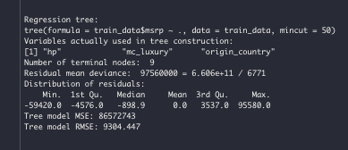
Model results
MSE | RMSE
86572743 | 9304.447

Slide 44
Model comparisons
Compare the 2 linear regression model and nonparametric model through measures of fit RMSE

Slide 45
insights
Pros and Cons from the different models. What the next recommended steps are moving forward to make predictions
Notes:
Pros_cons of regression capable of verus linear regression model provides cons – recomneded steps based off RMSE
A better model could be constructed with more itme and data

Slide 46
conclusion
Notes:
Quick summary of the findings in objective one
Quick summary of the findings and recommendations in objective 2
Additional discussion points: Scope of inference? What would you do if given more time? Recommendations moving forward? Insight the model gave? Etc.

Slide 47
Summary
Recap of findings from objective 1

Slide 48
Summary
Recap of findings and recommendations from objective 2

Slide 49
Summary
Additional discussion points

Slide 50
THANK YOU
TCabaza@smu.edu
RobL@smu.edu
JGChung@smu.edu

